Slide 1
Lesson 10: Consuming a REST API from React
10.1 Implementing a Data Model in a Server Application
10.2 Implementing a REST API in a Server Application
10.3 Getting Started with a React REST Client Application
10.4 Calling a REST Service
10.5 Using the async and await Keywords

Slide 2
Lesson 10: Consuming a REST API from React
10.1 Implementing a Data Model in a Server Application

Slide 3
Overview
We've implemented a Spring Boot app with a relational data model and a REST API
In IntelliJ, see project demo-full-stack-app
We'll review the data model initially:
The database schema
Entity classes
Repository
Then we'll review the REST API afterwards

Slide 4
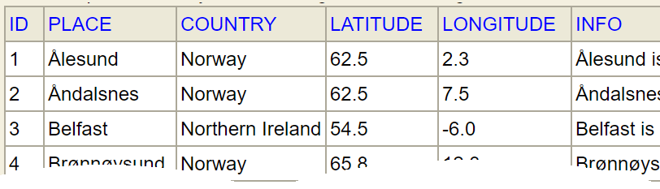
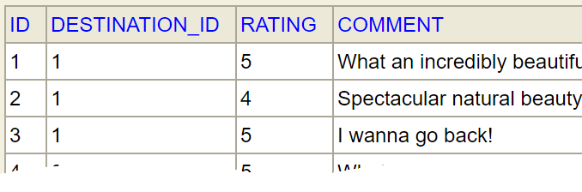
Reviewing the Database Schema
The database schema has 2 tables:
Note there are many reviews per destination
Via the DESTINATION_ID foreign key
Destinations
Reviews

Slide 5
Defining 1:Many Entity Relationships
One destination has many reviews:
@Entity
@Table(name="DESTINATIONS")
public class Destination {
…
@OneToMany(cascade=CascadeType.ALL, fetch=FetchType.EAGER)
@JoinColumn(name="DESTINATION_ID")
private List<Review> reviews;
}
Destination.java
@Entity
@Table(name="REVIEWS")
public class Review {
…
}
Review.java

Slide 6
Defining a CRUD Repository Interface
We've defined a CRUD repository interface to simplify persistence of destination entities:
Any changes we make to a destination entity will automatically cascade to review entities
Due to the "cascade" option:
public interface DestinationRepository extends CrudRepository<Destination, Long> {}
DestinationRepository.java
@Entity @Table(name="DESTINATIONS")
public class Destination {
…
@OneToMany(cascade=CascadeType.ALL, fetch=FetchType.EAGER)
@JoinColumn(name="DESTINATION_ID")
private List<Review> reviews;
}
Destination.java

Slide 7
Seeding the Database with Sample Data
We seed the database with sample data, as follows:
@Component
public class SeedDb {
@Autowired
JdbcTemplate jdbcTemplate;
@PostConstruct
public void init() {
jdbcTemplate.update("insert into DESTINATIONS … ");
…
jdbcTemplate.update("insert into REVIEWS … ");
…
}
}
SeedDb.java

Slide 8
Lesson 10: Consuming a REST API from React
10.2 Implementing a REST API in a Server Application

Slide 9
Overview
We've implemented a Spring Boot app with a relational data model and a REST API
In IntelliJ, see project demo-full-stack-app
We've reviewed the data model in the previous sub-lesson
Now we'll review the REST API…

Slide 10
Defining a REST Controller
We've defined a REST controller class as follows:
Note:
The REST controller autowires a repository to access destination data
@RestController
@RequestMapping("/destinations")
@CrossOrigin
public class DestinationController {
@Autowired
private DestinationRepository repository;
// REST endpoint methods …
}
DestinationController.java

Slide 11
Getting all Destinations
Here's a REST endpoint to get all destinations:
To test this endpoint, ping this URL:
http://localhost:8080/destinations
@GetMapping(produces={"application/json","application/xml"})
public ResponseEntity<Iterable<Destination>> getAll() {
return ResponseEntity.ok().body(repository.findAll());
}
DestinationController.java

Slide 12
Getting a Particular Destination
Here's a REST endpoint to get a destination by ID:
To test this endpoint, ping a URL such as:
http://localhost:8080/destinations/1
@GetMapping(
value="/{id}",
produces={"application/json","application/xml"})
public ResponseEntity<Destination> getById(@PathVariable long id) {
Optional<Destination> d = repository.findById(id);
if (d.isEmpty()) {
return ResponseEntity.notFound().build();
}
else {
return ResponseEntity.ok().body(d.get());
}
}
DestinationController.java

Slide 13
Adding a Review for a Destination
Here's a REST endpoint to add a review for a destination:
To test this endpoint, use a tool such as ARC
@PutMapping(
value="/addReviewForDestination/{destinationId}",
consumes={"application/json","application/xml"},
produces={"application/json","application/xml"}
)
public ResponseEntity<Void> addReviewFor(
@PathVariable long destinationId,
@RequestBody Review review) {
Optional<Destination> d = repository.findById(destinationId);
if (d.isEmpty()) {
return ResponseEntity.notFound().build();
}
else {
Destination destination = d.get();
destination.getReviews().add(review);
repository.save(destination);
return ResponseEntity.ok().build();
}
}
DestinationController.java

Slide 14
Lesson 10: Consuming a REST API from React
10.3 Getting Started with a React REST Client Application

Slide 15
Overview
We're going to see how a React client application can call a REST service implemented in Spring Boot:
React
client app
Spring Boot server app
Database
REST
SQL

Slide 16
Running the Applications
Run the Spring Boot server application first:
In IntelliJ, open demo-full-stack-app
Run the Application class
The server web application starts on port 8080
Now run the React client application:
Open a Command Prompt window in demo-react-ui
Run
Run
The client web application starts on port 3000
npm install
npm start

Slide 17
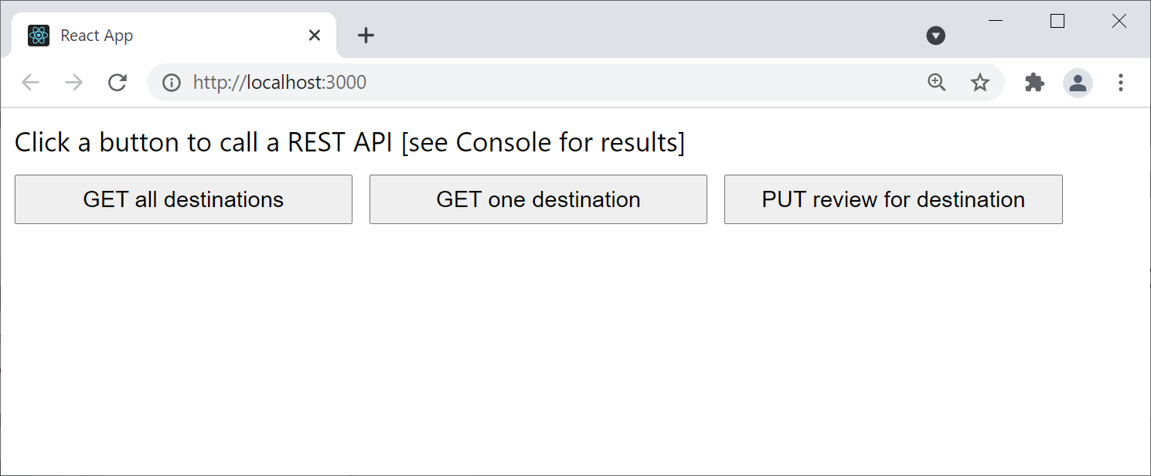
Using the React Client Application
The React client application has a very simple user interface
Each button sends a REST request to the server

Slide 18
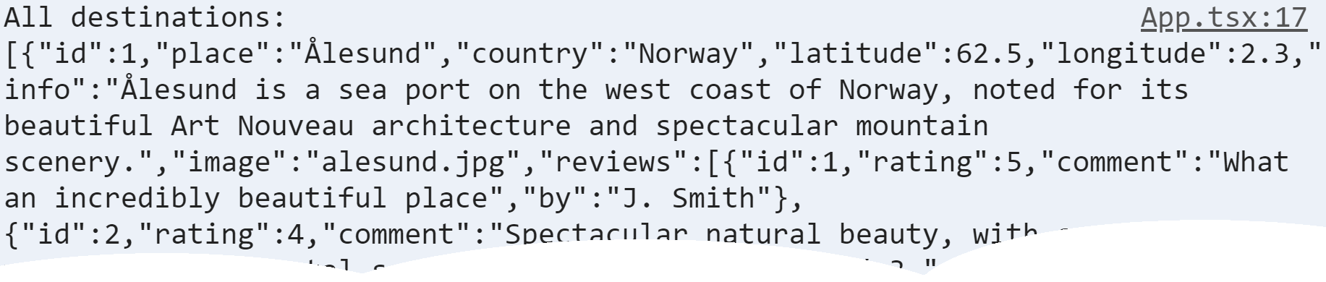
Getting all Destinations
Click the first button
Gets all destinations:

Slide 19
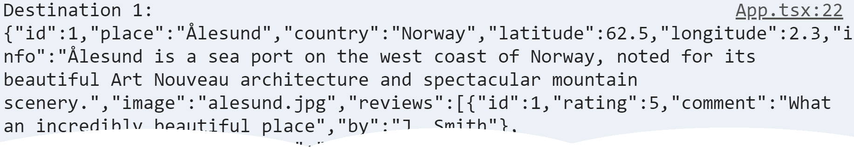
Getting one Destination
Click the second button
Gets one destination:

Slide 20
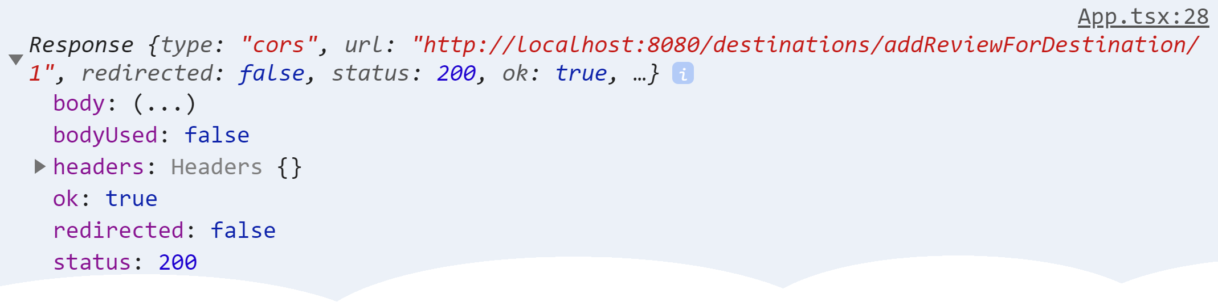
Adding a Review for a Destination
Click the third button
Adds a review for a destination:

Slide 21
Lesson 10: Consuming a REST API from React
10.4 Calling a REST Service

Slide 22
Overview
We're going to see how to call a REST service from JavaScript
Here's a reminder of how to run the server application:
In IntelliJ, open demo-full-stack-app
Run the Application class
Here's a reminder of how to run the React client application:
Open a Command Prompt window in demo-react-ui
Run
Run
npm install
npm start

Slide 23
Organizing Client Code
In a React application, it's a good idea to put all the REST code in a dedicated class (or loose functions)
See RestClient.ts
export default class RestClient {
static baseUrl = "http://localhost:8080"
// Define methods here, to invoke REST endpoints…
}
RestClient.ts

Slide 24
How to Call REST Endpoints via fetch()
The easiest way to call a REST endpoint is via fetch()
Takes a REST URL, and calls the REST endpoint asynchronously
Returns a Promise object immediately
Call then() on the Promise object, to register a call-back function
The Promise will invoke the call-back function when the REST response eventually arrives back
const aPromise = fetch(aUrl)
aPromise.then(response => {
// Process response … … …
})

Slide 25
Calling the REST Endpoint to Get all Destinations
Here's how we call the REST endpoint to get all destinations:
Note the call to response.json()
Extracts JSON string from the HTTP response body
Parses the JSON string into a JavaScript object
static getDestinations() : Promise<any> {
const url = `${RestClient.baseUrl}/destinations`
const promise1 = fetch(url)
const promise2 = promise1.then(response => {
return response.json()
})
return promise2
}
RestClient.ts

Slide 26
Displaying the Response
Here's how we display the response in our React UI code:
function demo1() {
const promise = RestClient.getDestinations()
promise.then(data =>
console.log(`All destinations: ${JSON.stringify(data)}`))
}
App.tsx

Slide 27
Lesson 10: Consuming a REST API from React
10.5 Using the async and await Keywords

Slide 28
Overview
We're going to see how to use the async and await keywords to simplify how to work with Promise objects
Here's a reminder of how to run our server application:
In IntelliJ, open demo-full-stack-app
Run the Application class
Here's a reminder of how to run our React client application:
Open a Command Prompt window in demo-react-ui
Run
Run
npm install
npm start

Slide 29
A Reminder About Using Promise Objects
When you invoke a REST service via fetch(), it returns a Promise object immediately
You can call then() on the Promise, to register a call-back
The Promise will invoke the call-back when the response is ready
let aPromise = fetch(aUrl)
aPromise.then(response => {
// Process response … … …
})

Slide 30
Calling a Series of Asynchronous Functions
If you call a series of asynchronous functions:
Each function will return a Promise object
You can end up with a series of cascading then() call-backs, which can get messy:
let promise1 = someAsyncFunc1()
let promise2 = promise1.then(result1 => {
return someAsyncFunc2()
})
let promise3 = promise2.then(result2 => {
return someAsyncFunc3()
})
// Etc.

Slide 31
Using the await Keyword to Simplify Promises
await can simplify how you work with Promise objects
Just put await before a function that returns a Promise
All subsequent code is implicitly reorganised into a then() call-back function for you
let result1 = await someAsyncFunc1()
let result2 = await someAsyncFunc2()
let result3 = await someAsyncFunc3()
equivalent
let promise1 = someAsyncFunc1()
let promise2 = promise1.then(result1 => {
return someAsyncFunc2()
})
let promise3 = promise2.then(result2 => {
return someAsyncFunc3()
})

Slide 32
Using async and await in Practice
If you use the await keyword within a function:
You must decorate your function with async, otherwise you'll get a compiler error when you use await
function async myFunctionThatUsesAwaitKeyword() {
let result1 = await someAsyncFunc1()
…
}

Slide 33
Using async and await to Get One Destination
Let's call the REST endpoint to get one destination
await keyword subscribes to Promise (implicit then)
async keyword allows us to use await
We can call the above function from our UI:
static async getDestination(id: number) : Promise<any> {
const url = `${RestClient.baseUrl}/destinations/${id}`
const response = await fetch(url)
return response.json()
}
RestClient.ts
async function demo2() {
const data = await RestClient.getDestination(1)
console.log(`Destination 1: ${JSON.stringify(data)}`)
}
App.tsx

Slide 34
Adding a Review for a Destination
Now let's call the REST endpoint to add (PUT) a review:
We can call the above function from our UI:
static addReview(id: number, review: any) : Promise<any> {
const url = `${RestClient.baseUrl}/destinations/addReviewForDestination/${id}`
return fetch(
url,
{
method: 'PUT',
headers: { 'Content-Type': 'application/json' },
body: JSON.stringify(review)
}
)
}
RestClient.ts
async function demo3() {
const aReview = {rating: 5, comment: 'FANTASTIC', by: 'Andy'}
const addResponse = await RestClient.addReview(1, aReview)
console.log(addResponse)
}
App.tsx

